Slide 1
PROBLEM STATEMENT - 02
LLM, Find My Fund!
PHOENIX CODERS - GROUP 31

Slide 2
OBJECTIVE OF THE PROBLEM STATEMENT
To build a lightweight, intelligent search system that can accurately map a user's vague or fuzzy query to the correct Indian mutual fund, stock, or ETF.
To go beyond traditional string matching by using a Small Language Model (SLM) and semantic embeddings to understand user intent
To leverage metadata (fund house, category, sector, AUM, holdings) to:
To leverage metadata (fund house, category, sector, AUM, holdings) to:
Improve result precision
Disambiguate similar-sounding funds

Slide 3
DATA PREPROCESSING
Loaded 3 separate datasets in JSON Format:
Mutual Fund Master Data (mutual_funds.json)
Fund Holdings Data (fund_holdings.json)
Stock Metadata (stocks.json)
Converted JSON → DataFrames using pandas.read_json() and json_normalize()
Ensured data structure is flat and accessible for modeling
Merged datasets using:
fund_id to link mutual funds ↔ holdings
stock_id to link holdings ↔ stock metadata
Created a consolidated view of each fund with its name, sector, category, holdings, AUM, and other metadata

Slide 4
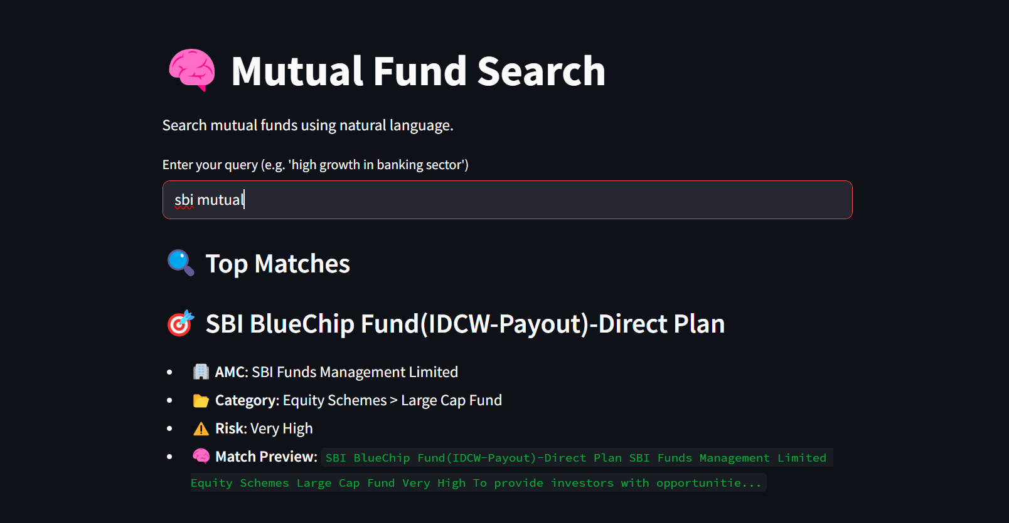
DEMO SCREENS

Slide 5
EVALUATIONS
ACCURACY : 80-85%
RESPONSE TIME : Average Response Time: 4.1 seconds tested on 10 diverse queries.

Slide 6
CONCLUSIONS
Our system uses small language models (MiniLM/BGE) for embeddings and vector search for high-speed retrieval.
Achieved an average response time of ~4.1seconds across diverse query types.
Enabled smart matching even on queries with:
Typos (e.g., "icci infr")
Partial names (e.g., "tax fund")
Intent-based filters (e.g., "funds with infosys", "AUM > 1000cr")

